Slide 1
CS487-Introduction to competitive programming: A2SV
Lecture #6: Data Structures

Slide 2
What are Data Structures
Particular way of organizing data
Tools to build efficient algorithms
Commonly used because needed often
The right one depends on the task

Slide 3
Data Structures
Array
Vector
Stack
Queue
Linked List
Set
Map
Tree
Binary tree
Heap
Binary search tree
AVL tree
Segment tree
Binary Index tree
Trie

Slide 4
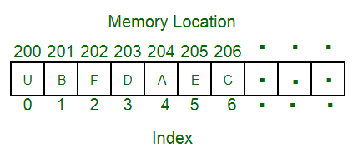
Array
Collection of items, stored at contiguous memory location

Slide 5
Vectors
Dynamic arrays with the ability to resize itself automatically when an element is inserted or deleted
Basic idea: Double the size when it reaches capacity, cut by half when it’s down to quarter

Slide 6
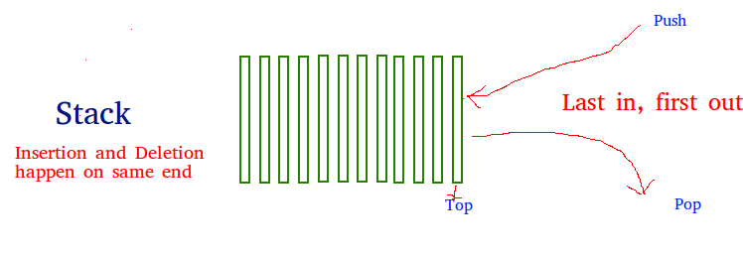
Stack
Linear data structure; LIFO(last in first out) You can think of a basket

Slide 7
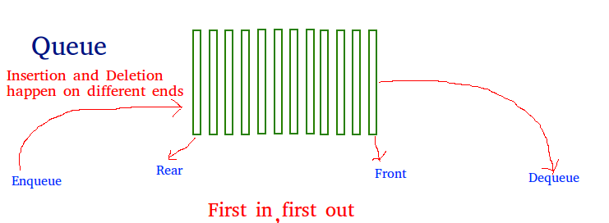
Queue
Linear data structure; FIFO(first in first out) You can think of a queue for bank, bread, anything. :)

Slide 8
Programming exercises
Prefix calculator
Input: A prefix expression calculator
Sample: + 4 * 3 12
Output: Result
Sample: 40

Slide 9
Quote of the day
“Sweat in the training field more to bleed less in the battleground.”

